Slide 1
Engagement of International Consulting Company for designing the Model Framework Structure and Content for the issuance of Green Bonds in Armenia (Green Bond Framework) Assignment outcomes & developed tools

Slide 2
Green bonds – general aspects

Slide 3
Estimated costs of climate (mitigation) measures in Armenia
Climate mitigation sectors (Armenia) | Estimated amount, USD million
Renewable energy (hydropower plants, wind plants, solar plants) | 1,395
Combined-cycle gas turbine plants | 1,200
Energy efficiency for residential buildings | 1,200
Energy efficiency for public buildings | 294
Energy efficiency for industrial buildings | 144
Transport | 265
Waste management | 174
Total | 4,672

Slide 4
Advantages of green bonds
Flexibility of the instrument (reflected in terms of the issuer requirements, types of issuances, and the terms of issuances)
New low-cost financing channel and ability to attract institutional capital, lower interest rate, pricing advantages (can be observed as a result of the green label), long term repayment/refinancing profile, lower cost of capital
Access to international capital & investor diversification
Increased efficiency/transparency in financial infrastructure using certification and audits by reputable institutions
Green bond, an attractive debt instrument for small and medium-size utilities

Slide 5
Green bond issuers
Certified Climate Bonds can be issued by a variety of different organisations seeking to finance or re-finance low-carbon developments. The focus for green bond Certification is the low carbon 'portfolio' or 'projects & assets' being financed by the green bond, rather than the entity which is issuing it, such as:
Project developers
Utilities
Equipment manufacturers
Banks
Aggregators
Local Governments
State backed entities
National Governments (sovereign)

Slide 6
Opportunities of green bonds
Strong investor interest and momentum for growth / exponential curve of green capital with more capital than yesterday but less than tomorrow – Growing market – doubling every year, currently strong over-subscription (D>O)
Presence of favourable governmental policies combined with a worldwide momentum and an improving legal framework.
Social / Citizen / Customers pressure on companies for taking sustainable actions to ever go greener.
Financial markets and investors are requested to evolve and adapt and finance the transition to low-carbon and climate resilient growth.
Option for investors to achieve a greater diversification of portfolios

Slide 7
Green Bond Market Size

Slide 8
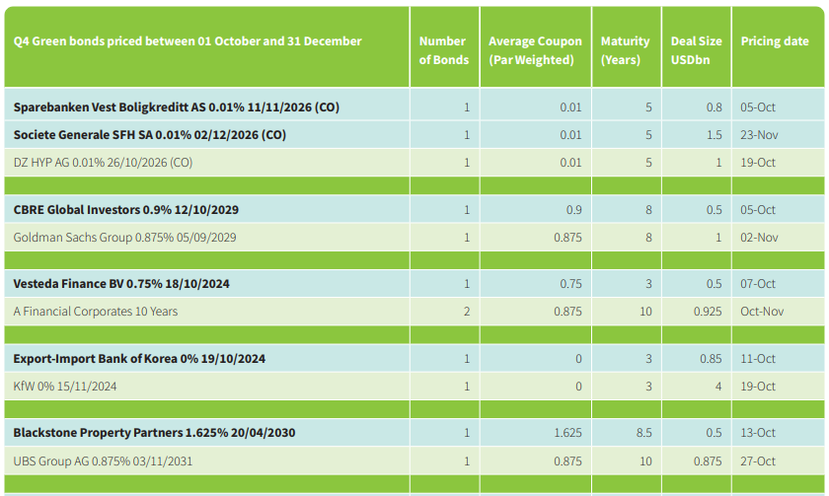
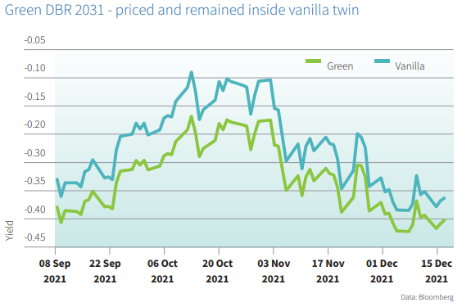
Green bond pricing: Greenium on pricing

Slide 9
Green bonds standards
Components of green bonds frameworks
A green bond standard can include various components – currently there is no absolute consensus in the market on what should be included within ‘a standard’
Green bonds frameworks mainly differ based on:
Project categories
Sectors available
Reporting requirements
Reference to the framework
External review / verification requirements
External review
Publication of external review
Types of projects and eligibility
Impact reporting
Accreditation of external reviewers
Indicators and metrics
Allocation reporting

Slide 10
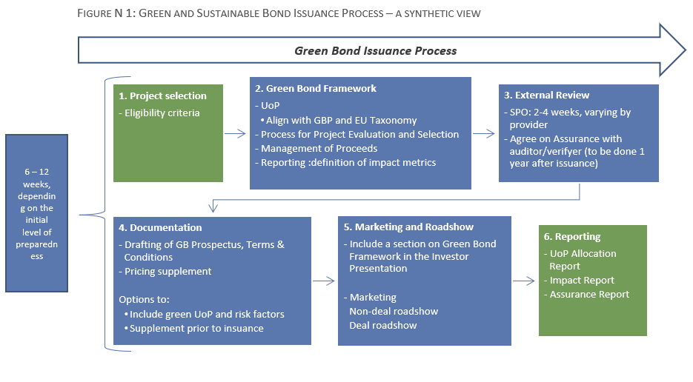
Green bond issuance process

Slide 11
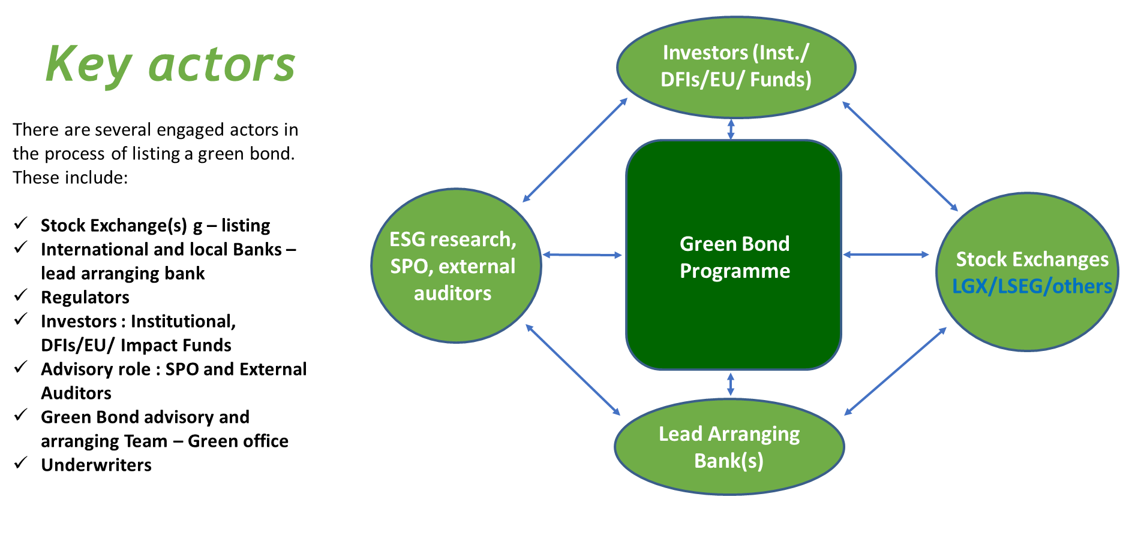
Green bond Issuance: Key stakeholders

Slide 12
Assignment objectives, timeline and outputs

Slide 13
Assignment objective
4-month assignment (March – July 2022) to assist Armenian banks and non-banking financial institutions in attracting financing through issuance of the Green Bonds
Work with competitively selected entities on “Design of the Model Framework Structure and Content for the issuance of Green Bonds”
Proposed framework and standards to be met:
use of proceeds - i.e. types of investments to be included)
project / investment selection – i.e. the process by which an investment can be included in the green bond
management of proceeds
reporting
Advice on how to integrate into business practices
Tools / checklists for measurement, reporting, and verification
An additional phase (structuring in bringing the bonds to market) would be necessary including assistance in preparation for approaching the market - specifically verification providers (but potentially also other actors) - Legal / terms and conditions and negotiations not covered by technical assistance

Slide 14
Main results
Workshops included participants from over 8 banks and 2 leasing institutions
2 applications were received within a call for selection of beneficiaries > 1 applicant received full technical assistance, including:
Drafting and finalisation of green bond framework
Introduction to SPOs and assistance with preparing Terms of References for selection of SPO
All interested parties received project outputs and trainings / workshops, which (hopefully) made them more familiar with green bond issuance process

Slide 15
Steps & timeline
APRIL Introducing green bonds
MAY
Selecting beneficiaries
APRIL – JULY
Green bond framework
JULY
Project screening and reporting tools
JULY
Integration of GB into existing processes
JULY
Selecting SPOs / Verifiers
Organised GB introduction workshop with potential beneficiaries
Meeting with AMX
Meeting with CBA
Designed set of criteria for selection of beneficiaries
Designed application template
Issuing call for selection
Evaluation of applications and selection of beneficiaries
Meetings with 2 banks
Developed structure for the Green Bond Framework
Developed Green Definition (Taxonomy) aligned with the selected standard
Use of proceeds
Management of proceeds
Allocation and impact reporting
Developed Eligibility and Screening Toolkit
Developed GHG footprint simplified calculator
Research on SPOs / independent verifiers
Introduced (potential) green bond issuers to SPO / verification providers
Developed ToR for selection of SPO

Slide 16
Project screening tool
Tool developed to support bank’s staff in project selection
an investment screening tool based on the ICMA standard
with a GHG calculator for various types of investments (elaborated in the following subsections).
The outputs of this tool could also be reused for allocation reporting (if required) and impact reporting, by aggregation of different deal sheets.
The developed tool consists of:
A general sheet with basic investment data
Sector project eligibility sheets (List of eligible technologies) intended for the evaluation of investments
GHG calculator for renewable energy, transport and buildings sector
List of parameters to collect from sub-borrowers and principles of its integration to formulate and disclose impact reporting figures
The tool was made available to interested parties / attendees of workshops

Slide 17
Project screening tool
Specific measurable ICMA indicators were used where they exist.
For types of investments where ICMA indicators are only generalized, criteria have been developed in line with ICMA standards, i.e. they are not the opposite of them.
Mandatory criteria mainly relate to GHG emissions, reduction of fossil fuel use, sustainability, impact on climate change and the environment.
The calculation of GHG emissions takes into account the total emission savings over the entire life cycle of the investment.
GHG calculation developed for renewable sources, buildings and transport sector
Some criteria are very specific, and some are only descriptive.
There is potential for the development of tools for additional sectors, with or without GHG emissions calculations, depending on the bank's policies and intentions.

Slide 18
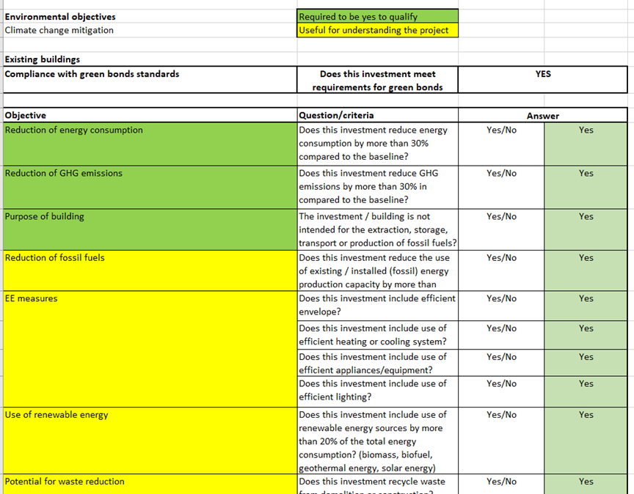

Project screening tool
Clicking on one of the types of investments / sectors, automatically switches to a new sheet:
dedicated to that type of investment

Slide 19
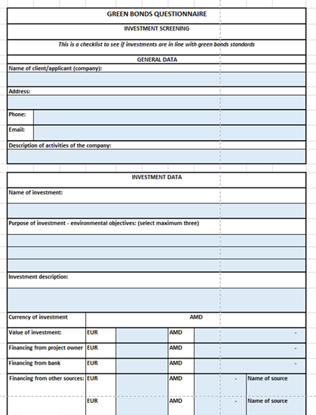
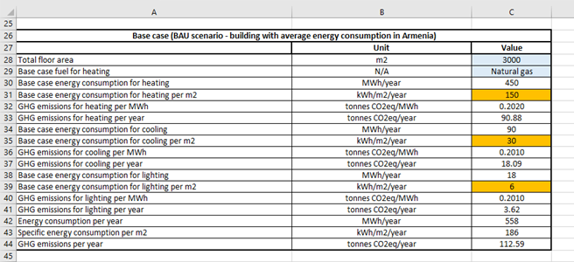
Project screening tool

Slide 20
Other useful outputs of the assignment
Green Bond Framework
Description of issuer
Recommendations of integrating green bonds framework with existing governance structures
Use of proceeds, Management of proceeds
Guidance on selection of Green Bond Second Party Opinions (SPO)
Role of SPOs, pre- and post-issuance certification, SPO process
Project origination, selection, technical / ESG appraisal, monitoring and reporting
GB allocation and impact reporting
Template for procuring SPO / ToR
Management of proceeds
Reporting
Selection of projects / Green project criteria
Eligibility principles

Slide 21

Contact
Seth Landau, seth@ecoltdgroup.com
James Naughton, James_Naughton@dai.com
Yves Speeckaert, yves.speeckaert@emergy.lu
Tamara Trumbić, tamara@ecoltdgroup.com
Miodrag Grujić, miodrag@ecoltdgroup.com
Lilit Gharayan, l.gharayan@adwise.am

Slide 22
Questions / Answers / Discussion

Slide 23
Questions & Answers
Open discussion
What is your interest in developing / issuing a green bond over the next 1-2 years?
What are the bottlenecks / barriers for your institution to enter in such sustainable finance instruments?
What types of investments are most interesting? Is there any particular sectors that may require “Green debt” financing?

Slide 24
Questions & Answers
Open discussion
Plans for legal and regulatory framework supporting green bonds/finance?
Green finance practices in Armenia (asset side)? What is your view on the green finance market perspectives?
Funding sources for green finance…

Slide 25
ANNEXES – ADDITIONAL INFORMATION

Slide 26
Sectors - categories of investments/projects and eligibility criteria

Slide 27
Green bond standards
Comparing list of eligible sectors through different standards
CBI Green Bonds Standard | ICMA Green Bonds Principles | EU Green Bonds Standard
Bioenergy; Geothermal energy; Marine renewable energy; Solar energy; Wind energy | Renewable energy | Electricity, gas, steam and air conditioning supply
Buildings | Energy efficiency | Buildings
 | Pollution prevention and control | Manufacturing
Agriculture; Protected agriculture; Forestry | Sustainable management of living natural resources | Agriculture and forestry
Land conservation & restoration | Terrestrial and aquatic biodiversity conservation
Low carbon transport; Shipping | Clean transportation | Transport
Waste Management; Water Infrastructure | Sustainable water management (including clean and/or drinking water) | Water, waste and sewerage remediation
Climate Resilience Principles (see here) | Climate Adaptation
 | Eco-efficient products, production technologies and processes | ICT

Slide 28
ICMA sectors and eligibility criteria
The Bank’s Green Bond Framework is aligned with ICMA GB Principle.
Category | Eligible Areas
Renewable Energy | Production, Transmission, Appliances and Products
Energy Efficiency | New and Refurbished Buildings, Energy Storage, District Heating, Smart Grids, Appliances and Products
Pollution Prevention and Control | Reduction of Air Emissions, GHG Control, Soil Remediation, Waste Prevention, Waste Reduction, Waste Recycling and Energy/ Emission-Efficient Waste to Energy
Environmentally Sustainable Management of Living Natural Resources and Land Use | Environmentally Sustainable Agriculture; Environmentally Sustainable Animal Husbandry; Climate Smart Farm Inputs such as Biological Crop Protection or Drip-Irrigation; Environmentally Sustainable Fishery and Aquaculture; Environmentally Sustainable Forestry, Including Afforestation or Reforestation, and Preservation or Restoration of Natural Landscapes
Terrestrial and Aquatic Biodiversity Conservation | Protection of Coastal, Marine and Watershed Environments
Clean Transportation | Electric, Hybrid, Public, Rail, Non-Motorised, Multi-Modal Transportation, Infrastructure for Clean Energy Vehicles and Reduction of Harmful Emission
Sustainable Water and Wastewater Management | Sustainable Infrastructure for Clean and/or Drinking Water, Wastewater Treatment, Sustainable Urban Drainage Systems and River Training and Other Forms of Flooding Mitigation
Climate Change Adaptation | Efforts to Make Infrastructure More Resilient to Impacts of Climate Change, as well as Information Support Systems, such as Climate Observation and Early Warning Systems
Circular Economy Adapted Products, Production Technologies and Processes | The Design and Introduction of Reusable, Recyclable and Refurbished Materials, Components and Products; Circular Tools and Services); and/or Certified Eco-Efficient Products
Green Buildings | Buildings that meet Regional, National or Internationally Recognised Standards or Certifications for Environmental Performance

Slide 29
Tool – General sheet

Slide 30

Investment screening - general sheet
Applicant data

Slide 31


Investment screening - general sheet
Investment data - I

Slide 32



Investment screening - general sheet
Investment data - II

Slide 33


Investment screening - general sheet
Investment data - III

Slide 34
Tool – through sectoral sheets

Slide 35
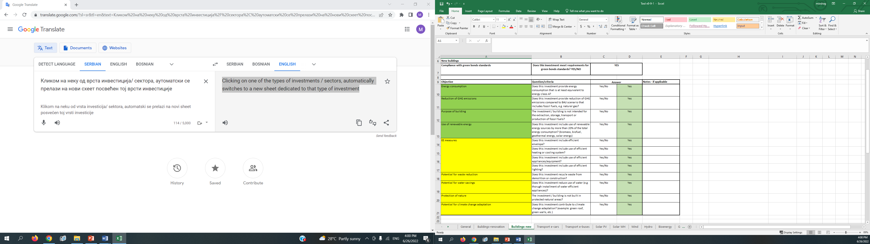
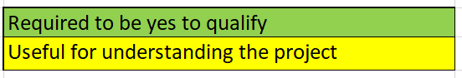
Sectoral sheets – some principles
If the answer to all green questions is "yes", the answer to the question of compliance with GB standards becomes “yes” automatically.

Slide 36
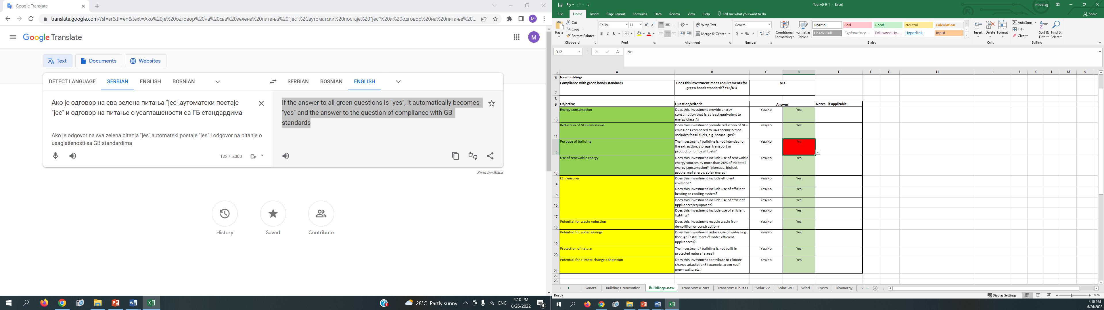
Sectoral sheets – some principles
Only one answer “no” to green questions is sufficient to generate answer “no” to the question of compliance with GB standards.

Slide 37
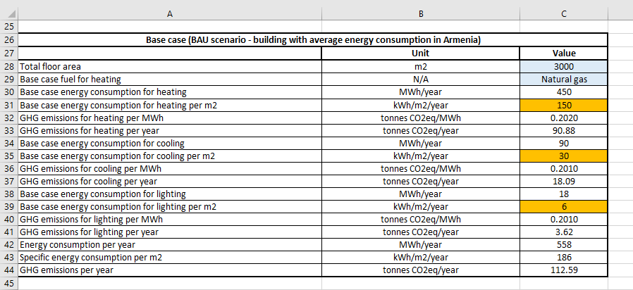
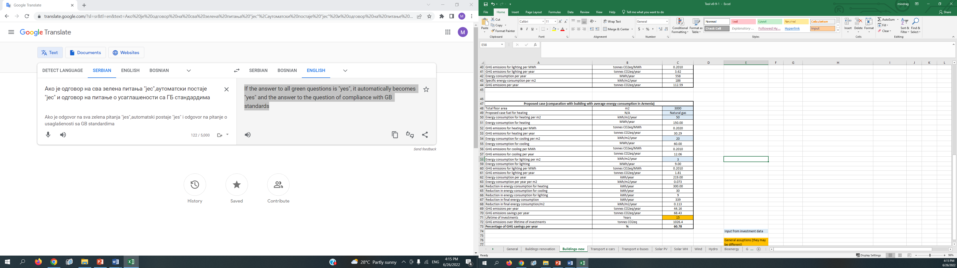
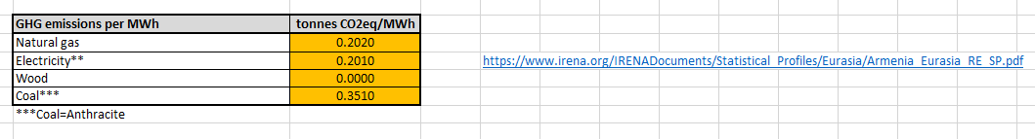
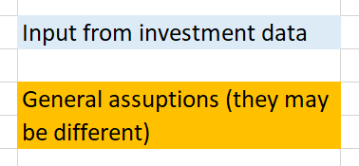
Sectoral sheets – GHG calculation
For most sectors (mitigation), a relatively simple model for calculating GHG emissions has been developed so that bank can estimate the impact of investments.

